Slide 1
Performance testing
What we learned
Darryl Shpak
Conquest Planning

Slide 2
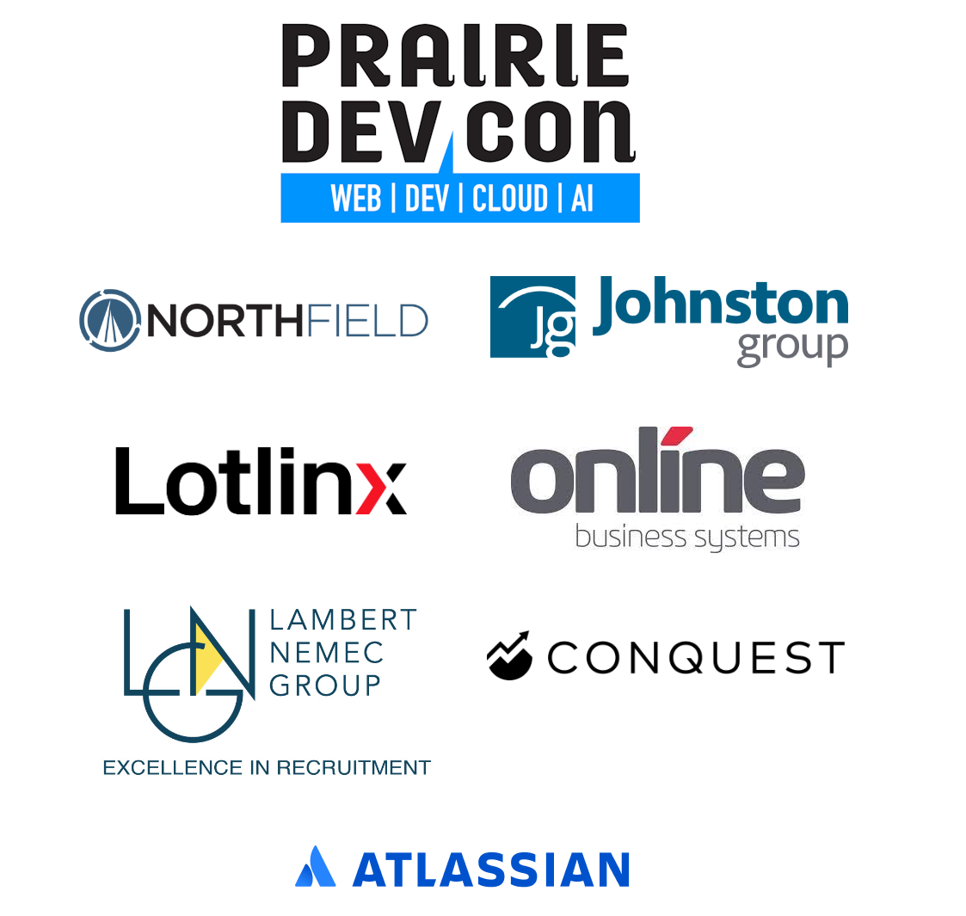

Slide 3
Me
Darryl Shpak
Director of Application Architecture, Conquest Planning
25 years in the Winnipeg tech industry
Conquest Planning
Winnipeg owned and operated
Founded in 2018
~150 people, mostly local
Financial planning software
Notes:
Name, “since 2019”
Conquest – Remember EISI?
We make financial planning software, and I’m going to talk a bit about that so that you know what problem I’m solving

Slide 4
Collect financial information
Perform simulation
Compare to goals
Evaluate possible variations
Notes:
Financial info: salary, savings, debts, goals (when do you want to retire? Are you saving for a big trip?)
Simulation is fine-grained – every day of your expected lifespan, including inflation, taxes, every paycheque or loan payment
Variations: what if you retire a year later? What if you sell your house and downsize? What if inflation is higher than expected?
Help you understand how close you are to meeting your goals, how robust your plan is, and what you can do to make it better
Motivation: it got slower…we think. Did it? Why?

Slide 5
Context for my project
Back-end web service
Compute-bound
C# / .Net
But most of this talk is generally applicable
Notes:
This is computationally expensive, and unusual for modern business software – not network- or database-bound.
C# 12 and .Net 8 – comes up in a couple examples but doesn’t “matter”
Most of what I’m talking about is generalizable
Ok, enough preamble, let’s get started

Slide 6
Talking about performance is hard
Lesson 1
Notes:
It’s hard to work on a project without talking about it!
Let’s say I’ve run a performance test. I run a bunch of requests against my service, collect some timings, make a code change, re-test, and then I tell you…

Slide 7
“This endpoint is 10% faster!”
Request time 100 ms → 90 ms?
Request rate 50/minute → 55/minute?
“This endpoint is 100% faster!”
Request time 100 ms → 0 ms?
Request rate 50/minute → 100/minute?
Notes:
What does that mean? There are at least two reasonable interpretations.
Those mean almost the same thing, but what if it was a bigger improvement, and I said…
What does that mean?
My experience is: different people will make different assumptions about what “10% faster” means.

Slide 8
What about…
“The endpoint is twice as fast”?
“The endpoint is 200% faster”?
“The endpoint is 25% slower”?
“The endpoint is twice as slow”?
Notes:
There are other statements you can make that sound clear and quantitative but can be confusing:

Slide 9
Use explicit metrics
“Response time dropped by 10%”
“Responses per minute on a single node increased by 55%”
“Average CPU usage on the cluster dropped by 12%”
Notes:
I’ve found that the way to cut through confusion is to not talk about “faster” or “slower” at all in quanitative terms, but to talk about specific metrics increasing or decreasing. Three examples:
…
What’s a 12% drop for CPU usage? 50% to 44% or 50% to 38%?
Of course, to talk about metrics changing, you need to have metrics to talk about! Which brings us to…

Slide 10
Measuring performance is hard
Lesson 2
Notes:
I cannot state this strongly enough. I’ve been doing this for a year and I’m still regularly surprised by how hard it is to answer the question of “is the app getting faster or slower?”

Slide 11
Results can change when…
…you deploy the code
…you test on a different machine
…you test on a different day
…you measure with a different metric or tool
…you test in a different deployed environment
Measurement noise can…
…fool you into thinking things have changed when they haven’t
…hide changes that have happened
Notes:
Here are some of the problems I’ve encountered: (seven bullets, two headings)
Being aware of noise is really important, or you can fool yourself! Joel Tosi talked a lot about this in his Systems Thinking talk yesterday.
These problems can be overcome, but they can be frustrating, and it helps to be aware of them before you start. It’s too easy to get excited about a 50% improvement that turns out to be 6% in production.
I’ll talk about some ways to mitigate these problems, but the key lesson here is…

Slide 12
Be cautious
Recognize that this is hard
Expect to be wrong
Verify results
Notes:
Do the verification before you make claims…to your manager, to your co-workers, or to yourself.
Now, while performance is intrinsically challenging to measure, there are errors you can make in the measurements that make it worse. Which is why we learned…

Slide 13
Automation is crucial
Lesson 3
Notes:
A lot of the challenges around measuring performance come from how sensitive the tests can be to the details of how they’re run, and the need to be very rigorous about how you execute your tests.
You know who’s good at being rigorous? Computers!

Slide 14
Performance can be affected by…
Speed of interaction
Resource contention
Build configuration
Subtle details in the test setup and execution
Notes:
Speed – how fast you clicked through the UI, how long you waited before starting the test
Resource – what else is running? Teams call? Virus scan? OS update?
Build – debug vs release? Incremental vs full? Updated a framework or library version?
Details – have you modified your test file? Did you click all the buttons in the same order? Any extra buttons? Any changes to your user settings?
At the beginning of a perf project, it’s reasonable to be doing a lot of ad hoc testing, which can mean that the test subtly morphs over time. As the project develops, you should have a good handle on “this is how I want a test to execute”. Then you can document it, but better yet, you can automate it.

Slide 15
Internal custom test execution tool
Switch to a git branch / commit
Full build
Launch service
Wait for startup
Pre-warm
Run test request in a loop
Write test configuration and results to disk
Repeat for other branches / commits
Clean up
Notes:
Late last year, I began working on a tool that ran tests for me.
(9 points)
Immediately made my tests more reliable and me more productive. It allows me to do things like this:

Slide 16
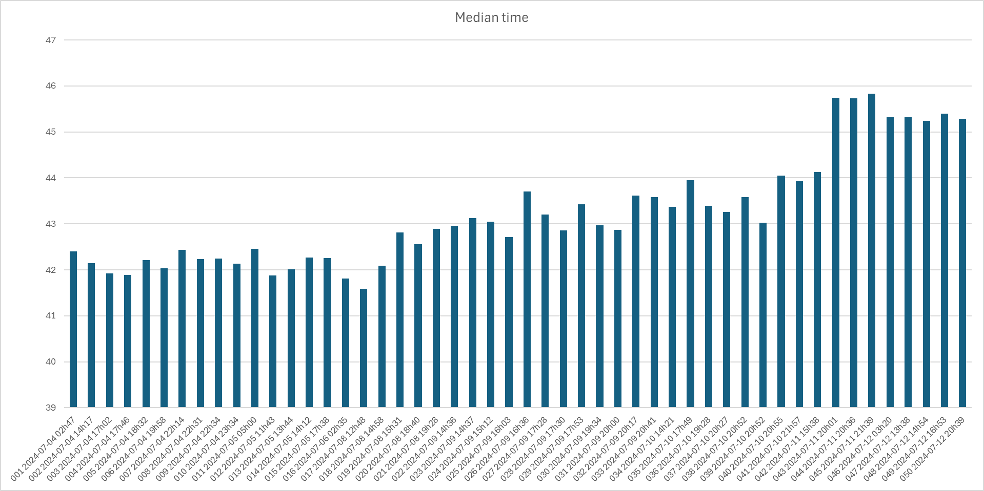
Notes:
With that tool, I could do things like this! [describe]
Over time, this turned from a personal ad-hoc script to a flexible tool that could be shared with the rest of the team.

Slide 17
Benefits
Saves developer time
Results are more stable
Greater confidence in comparisons
Others can reproduce your tests
Automation == documentation
Notes:
“Automation == documentation” – this helps with the communication challenges! If someone asks “how did you test that?” (or “how can I test my code?”), instead of explaining a process and missing details, you can point to the tool!
Better yet, this allowed me to learn my next lesson…

Slide 18
Don’t test on your workstation
Lesson 4

Slide 19
The story
I have a lot of tests to run
Selfishly, I want to use my computer
I looked into provisioning EC2 instances
Security is hard
Wait, don’t we have all these build machines?
Ran my tool from a TeamCity build
Saved time
To my surprise: much, much better test results
Notes:
Turns out, having dedicated cloud machines running zero other software in the background makes the tests more predictable!

Slide 20
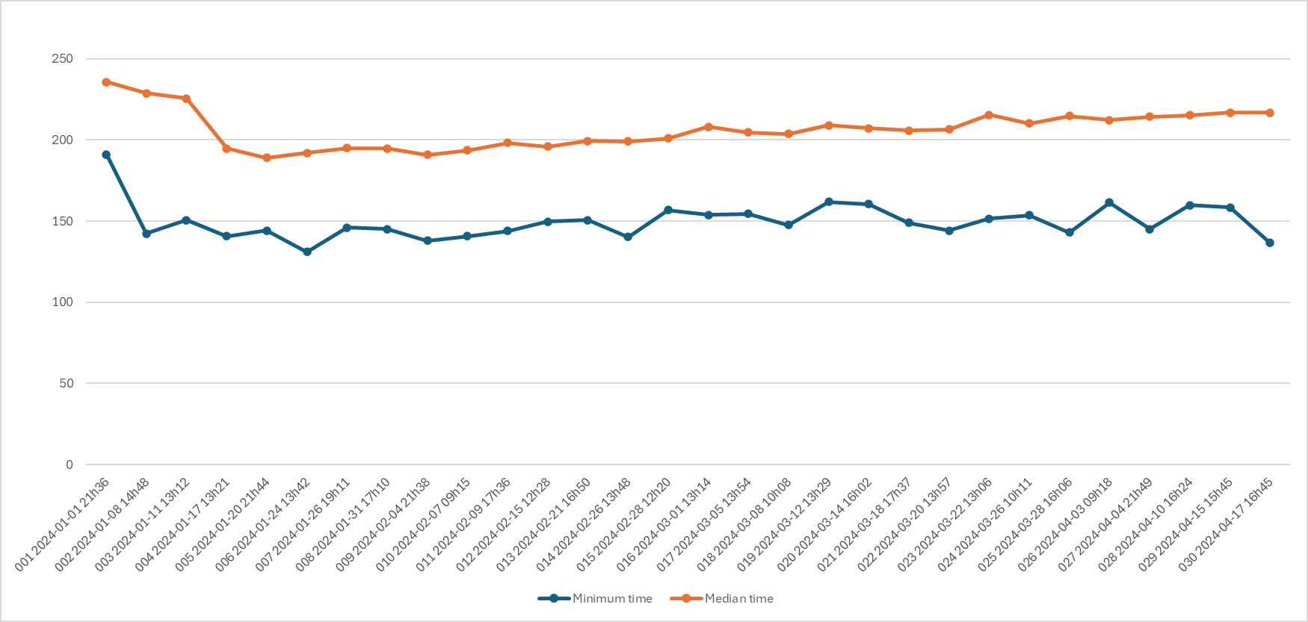
Notes:
This test run was local. You can kinda sorta see the trend

Slide 21
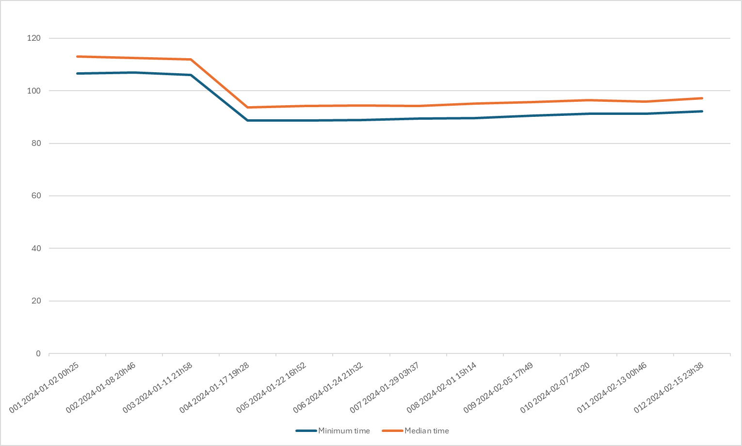
Notes:
This one was on the build machine. Slightly different graph because I am imperfect – this is a real result I dug up for this slide – but the noise has vanished! (It’s not always this good)
We were actually worried that running on cloud hardware would be less reliable, because “it’s not always the same computer”, “what if the machine is shared”, but the opposite was true.
If you’re serious about reproducibility: get a dedicated machine, cloud or otherwise. Don’t be afraid to turn your build system into a general job scheduler!

Slide 22
Trust your instincts
Lesson 5
Notes:
Software is big and complicated, you have to start somewhere. If you’re planning a perf project, you probably know what parts of your app concern you. We have a mix of fast and slow requests, and were concerned about the slow ones, where a 25% degradation would be more visible…and sure enough, that’s where people were complaining.

Slide 23
Ask yourself…
What’s the slowest part of the system?
What do people complain about?
What’s at risk of getting slower over time?
Where will cloud costs escalate?
Notes:
Start in those places!
And you’ll probably also have some intuition about why the problem areas are problems areas…

Slide 24
Listen to your senior people!
“I’ve always been suspicious of…”
“We use this bad pattern a lot…”
“This was rushed this into production without tuning…”
Notes:
I have a general philosophy that you ignore the instincts of a senior developer at your own risk. You’ll hear things like… (three points)
People know where the problems are. Listen to them.

Slide 25
Your instincts will be wrong
Lesson 6
Notes:
Of course, nobody’s perfect. A co-worker will make a suggestion, you’ll dismiss it as “that couldn’t possibly matter”, and they’ll be right. You’ll look at some code that you know is slow, and find out it doesn’t matter.
[story about report tags]
(click)

Slide 26

Computers are hard.
Unexpected interactions
Unintuitive dependencies
Be willing to be wrong
“Producing Wrong Data Without Doing Anything Obviously Wrong!” by Mytkowicz, Diwan, Hauswirth, and Sweeney (2009)
Notes:
Modern software and hardware is really, really complicated, causing measurement bias
[There’s a paper on this! Memory layout, cache locality, fuzzy linking]
Computers are weird and they won’t do what you expect. As a professional, you need to be able to recognize when you’re wrong.
If you’re interested in reading that paper, here it is

Slide 27
Question everything
Lesson 7
Notes:
Because you can’t trust your instincts, and because your measurements will sometimes be misleading, you need to question everything.

Slide 28
Be critical
What assumptions are you making?
What variables aren’t you controlling for?
What aren’t you measuring?
How do you know your results are statistically significant?
How do you know your results represent real-world usage?
Notes:
Approach performance testing as if the most annoying person you know is going to be trying to prove you wrong. Look for mistakes that you might be making.
(5 points)
This was, initially, really frustrating. There were times when it felt hopeless. More than once I said something like “I’ve decided I don’t know anything about how computers work”. But eventually, I learned to…
(click)

Slide 29
Accept this as part of the challenge
You will be wrong
Even if you’re careful
Notes:
Sometimes you just have to recognize that a hard thing is hard, but you can still do it! Just approach it with the knowledge that it’s hard.
If it was easy, I wouldn’t be giving this talk
One way to find out if you’re wrong is…(click)

Slide 30
Measure things in more than one way
Lesson 8
Notes:
This is the best way I’ve found to be confident in my statements about how app performance is doing. If two or more approaches give results that agree with each other, that’s a great sign. (click)

Slide 31
Things I’m doing:
Testing code snippets (LinqPad, BenchmarkDotNet)
Profiling (Visual Studio, dotTrace)
“Stopwatch testing” (Postman)
Black-box service testing (k6)
Black-box application testing (JMeter)
Runtime metric collection (Prometheus, Grafana)
Runtime request timing analysis (Cloudwatch)
Notes:
Here are some of the things we’re doing… (seven points)
This feels redundant, but they serve slightly different purposes, or they test the same thing with different tools…and we regularly see different results! (at least in terms of scale)
They can also give you a different perspective. Back in June we found a performance improvement, and testing with k6 showed “yep, the requests are faster now”. Which is great, but most of these requests were already “fast enough”. However…(click)

Slide 32
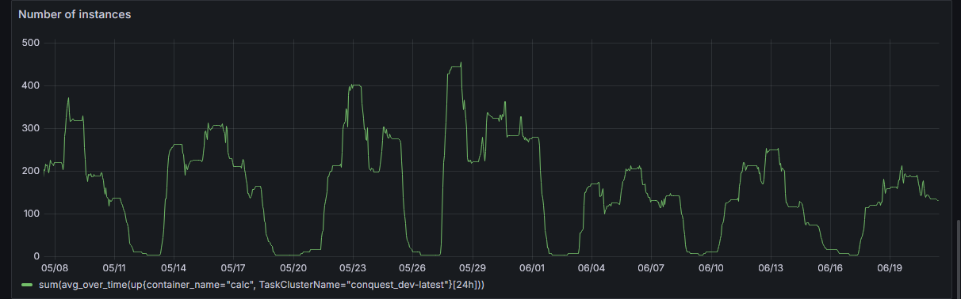
Notes:
This is a graph showing our dev environment in the weeks before and after the change was made. This is showing how big our cluster scaled (look, you can see Victoria Day weekend! the y axis labels are bunk, ignore them). This is a completely different view on the improvement: sure, our requests got slightly faster, but we are saving money here!
Autoscaling can hide performance problems, but autoscaling can also be the result of a performance problem! Look at things from as many angles as you can think of.

Slide 33
More eyes find more problems
Lesson 9
Notes:
That performance improvement I just showed? I would have never thought of it. A co-worker did. I was taking a completely different approach, looking at the commit history to find degradation, and looking for low-hanging fruit in our request pipeline, that sort of thing. Big-picture stuff. He was deep in the code base, trying to improve performance on a particular operation, did some profiling, and found that one library method, IEnumerable.Concat(), was way slower than we expected. And we used it in a bunch of places, not just in the piece of code he was looking at. The approach I was taking was far, far away from being able to identify this.

Slide 34
You can’t think of everything
Work independently, but share information
Let people investigate “dead ends”
Crowdsource your ideas
Notes:
(Three points)
And I’m going to take some credit for that gain; there were some other fixers that went in at the same time, and one of them was something that I had identified and got another dev to look at. No one of us alone would have made that big an improvement; it was a group achievement.

Slide 35
Know your tech stack
Lesson 10
Notes:
IEnumerable.Concat() is a super nerdy little detail in the library. Unfortunately, the details matter.

Slide 36
Problems hide in the details
So, you want a read-only dictionary?
ImmutableDictionary<>
FrozenDictionary<>
ReadOnlyDictionary<>
Dictionary<> cast to IReadOnlyDictionary<>
It pays to know your tools!
Spend time learning them
Notes:
Here’s another one that came up – four ways to solve the same problem
They all perform differently, and the differences are not obvious…but they’re huge.
(spend time learning them): Read release notes. Read blogs. Poke around the docs. Ask yourself “Wait, why are there two read-only dictionaries?”
I’m not here to call out “these are two problem areas in .NET”. That’s a different talk. Maybe that talk explains how to reduce garbage collection time too; I’d love to attend that one. The point is that libraries and tools are big and complicated and there is always more to learn.
[Autofac story!]

Slide 37
There’s no one right approach
Lesson 11
Notes:
So, I’ve been talking about performance being hard, but I’ve also been showing evidence that we’ve had success on this project. Hopefully the successes are getting some of you thinking “Yeah, we need to do some of this!”, but this talk is mostly about challenges, which is kind of dispiriting. “I want to make performance better” is a great goal but it’s an overwhelming task. Where do you even start?
(click)

Slide 38
Where do you begin?
Collect metrics and observe trends
Run benchmarks on historical builds
Use a profiler to find hotspots
Follow up on user complaints
Start a holistic design review
Fix known problems
Notes:
(six points)
None of these are wrong. All of them can be fruitful. Pick one and start! The one you know how to do, or the one that feels right. If you’ve got multiple people working on this project, you can take different approaches.
Finally, perhaps the most important lesson I learned…

Slide 39
Visibility is crucial
Lesson 12
Notes:
You want every developer to be thinking about performance, just like you want every developer thinking about quality, security, localization, and a million other things. Get performance on people’s minds.

Slide 40
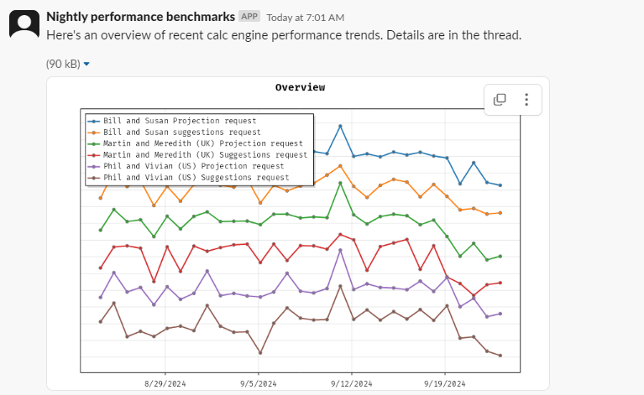
Notes:
I think this is the single most effective thing I’ve done. [explain what it is]. We’ve made a bunch of performance improvements, but this is what’s driving our long-term approach.<click>

Slide 41
The results
We catch slow code quickly
We see the effect of performance improvements
People are thinking about performance
Developers are more conscious of the performance decisions they’re making
Notes:
(four points) Nobody wants to be the one to slow down the app, just like nobody wants to be the one to break the build. Mistakes happen, suboptimal code goes in, and you don’t want a culture of blame here. But something like this lets you say “Hey, that code you put in last week? It caused this bump, and we need to fix that”.

Slide 42
Where do you go from here?

Slide 43
That’s up to you
Performance is an ideal, not a project
The domain is complicated
There are lots of ways to start
There are lots of ways to get frustrated and disillusioned
Notes:
We’ve gone from hyper-focused on performance, to code quality, to shipping 1.0, to sustainably adding features…including, again, performance
(three more points)
The lesson here is that it is hard, but it is not impossible. (click)

Slide 44
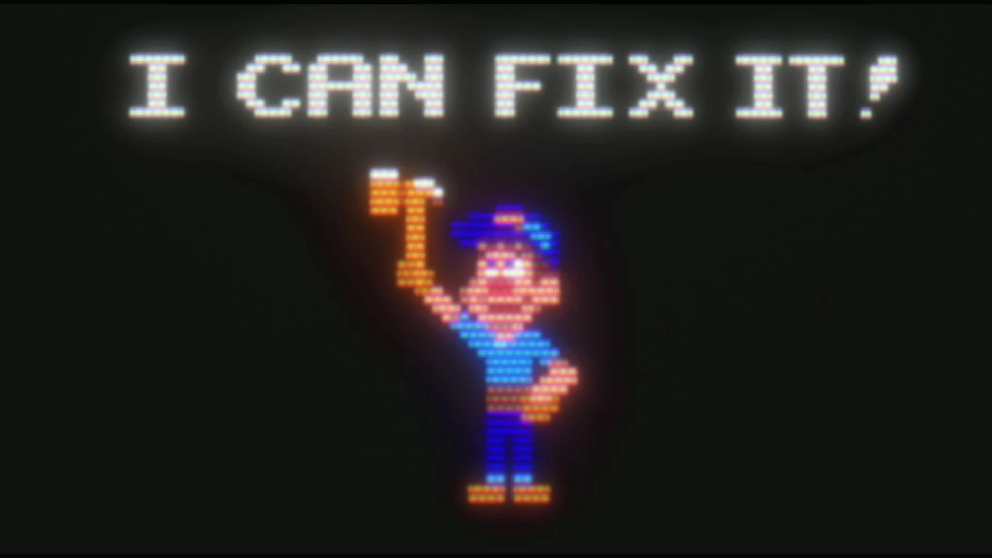

Thanks for listening!
← Session survey
darryl@conquestplanning.com
Notes:
You can do this. I’m not a performance wizard. I still don’t understand some pretty basic concepts around things like garbage collection and thread pooling that I really need to look into (advice???). And I’ve been successful leading this project – with the help of some fantastic developers. Couldn’t have done it alone. I hope that you can learn from some of my experiences, avoid some of the frustration and dead ends that I hit, and be inspired to make some improvements in your own projects.
(click) [thanks, questions, etc]

